Slide 1

Social Media Analytics
SQL Project:
A comprehensive database analysis project demonstrating advanced SQL techniques and business intelligence insights from social media data.
Presented by K. Gopi Chand

Slide 2
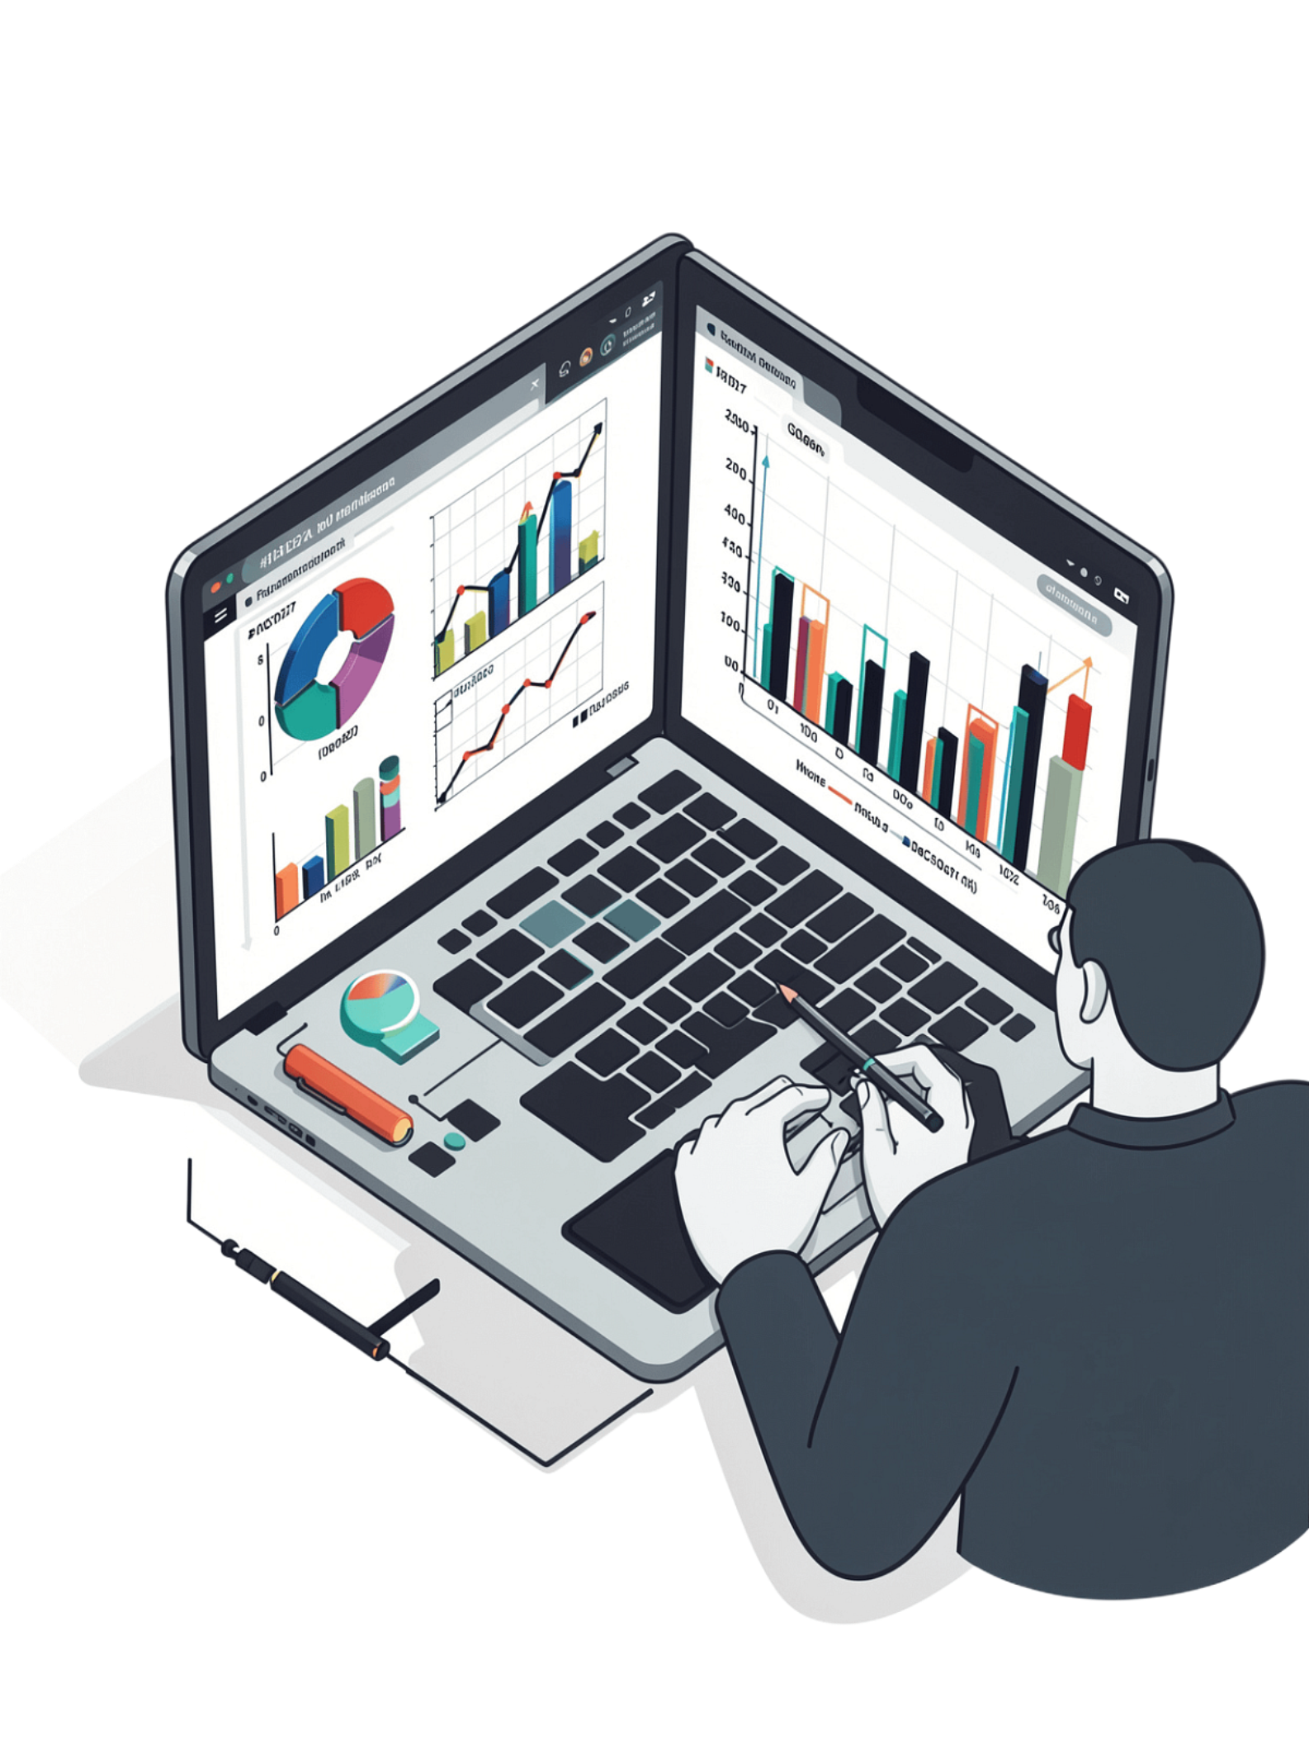
Introduction & Problem Statement
Project Goal
Analyze social media user behavior and engagement patterns to surface actionable intelligence.
The Problem
How can platforms identify top creators, trending content, and optimize user engagement at scale?
Dataset
7,000+ synthetic social media records across 7 interconnected relational tables.
Why It Matters
Insights drive influencer marketing, content strategy, and user retention decisions.

Slide 3

Approach & Methodology
Data Source & Structure
Synthetic social media dataset with 7,000+ records spanning seven interconnected tables:
users, posts, comments, likes
followers, hashtags, post_hashtags
Key Steps
Data Exploration: Analyzed table relationships and data quality
Query Development: Built 10 core analytical queries + 4 bonus challenges
Optimization: Applied indexing and JOIN optimization techniques

Slide 4
Tech Stack & Tools
Database
Advanced SQL
MySQL Server as the primary relational database engine for all queries and storage.
Complex JOINs, CTEs, window functions, and aggregate functions for multi-table analysis.
GenAI Assistance
Analysis Approach
AI-powered query optimization and syntax validation to accelerate development and reduce errors.
Data-driven insights translated into business decision-making frameworks and recommendations.

Slide 5

Key Insights & Results — Part 1
Top Active Users
Viral Content
Geographic Trends
Posts with 100+ likes uncovered clear content patterns driving virality
10 users identified with highest combined posts + comments activity
Certain countries show 3–5× higher engagement rates than average
Influencer IDs
Top 10 users carry 500–2,000+ followers each — prime for partnerships

Slide 6
Key Insights & Results — Part 2
15+
6–9 PM
Trending Hashtags
Peak Engagement
Each used in 20+ posts, revealing community-driven content clusters
Evening hours and weekends drive the highest interaction rates platform-wide
12%
8%
Inactive Users
Mutual Followers
Never posted, liked, or commented — a re-engagement opportunity
Reciprocal follow relationships indicating genuine community bonds

Slide 7

Challenges & Learnings
Key Challenges
Solutions & Learnings
Complex JOINs: Managing 7-table relationships required careful, deliberate query design
Performance: Optimizing queries across 7,000+ records to maintain acceptable speed
Used CTEs (Common Table Expressions) for cleaner, more readable, modular queries
Applied proper indexing and aggregate function optimization for speed
GenAI significantly reduced syntax errors and improved overall query accuracy

Slide 8
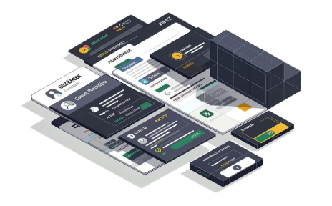


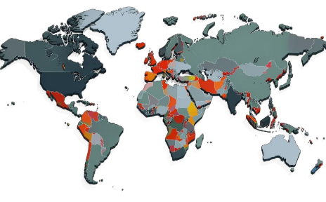
Business Impact & Applications
Influencer Marketing
Content Strategy
User Retention
Geographic Expansion
Identify and partner with top creators to power high-ROI campaigns.
Leverage trending topics and optimal posting windows to maximize reach.
Re-engage inactive users through targeted, personalized campaigns.
Focus resources on high-engagement regions for accelerated growth.

Slide 9
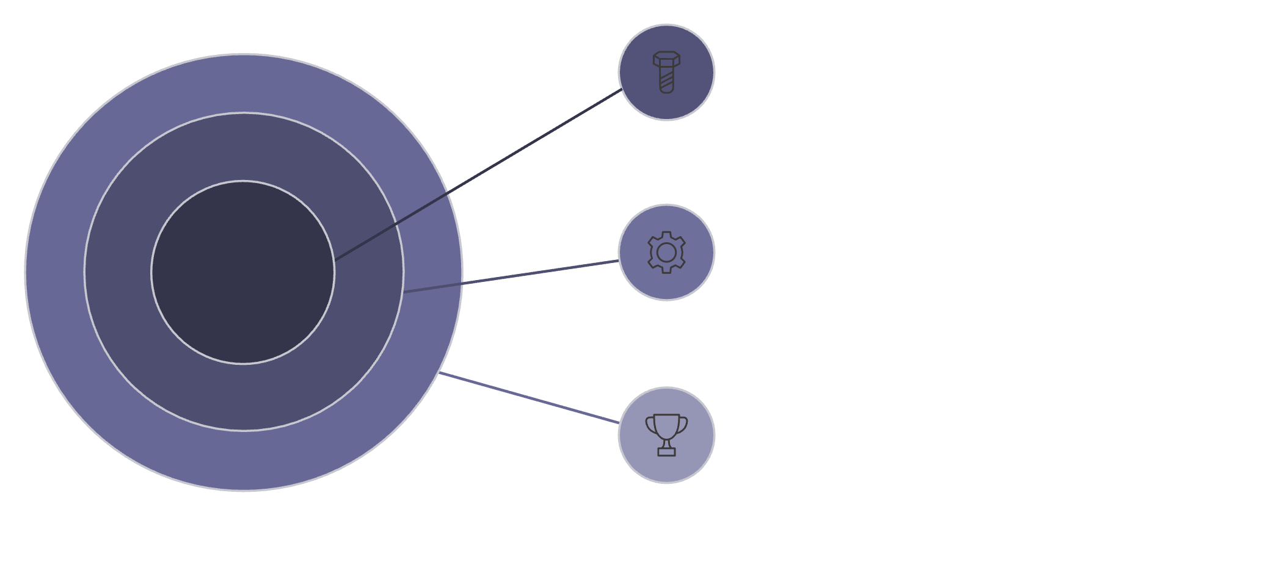

Technical Deep Dive: SQL Queries
Query Coverage
Q1–Q5: User activity, viral content, geographic trends, hashtags, influencers
Q6–Q10: Inactive followers, engagement scores, posting patterns, inactive users, country analysis
Bonus: Engagement rates, mutual followers, influencer hashtags, country leaderboards
Core Queries
Q1–Q5: user activity, viral content, hashtags.
Advanced Queries
Q6–Q10: inactive followers, engagement scores, patterns.
Bonus Challenges
Engagement rates, mutuals, influencer hashtags.
14 total queries delivered — 10 core + 4 bonus challenges — all on schedule.

Slide 10
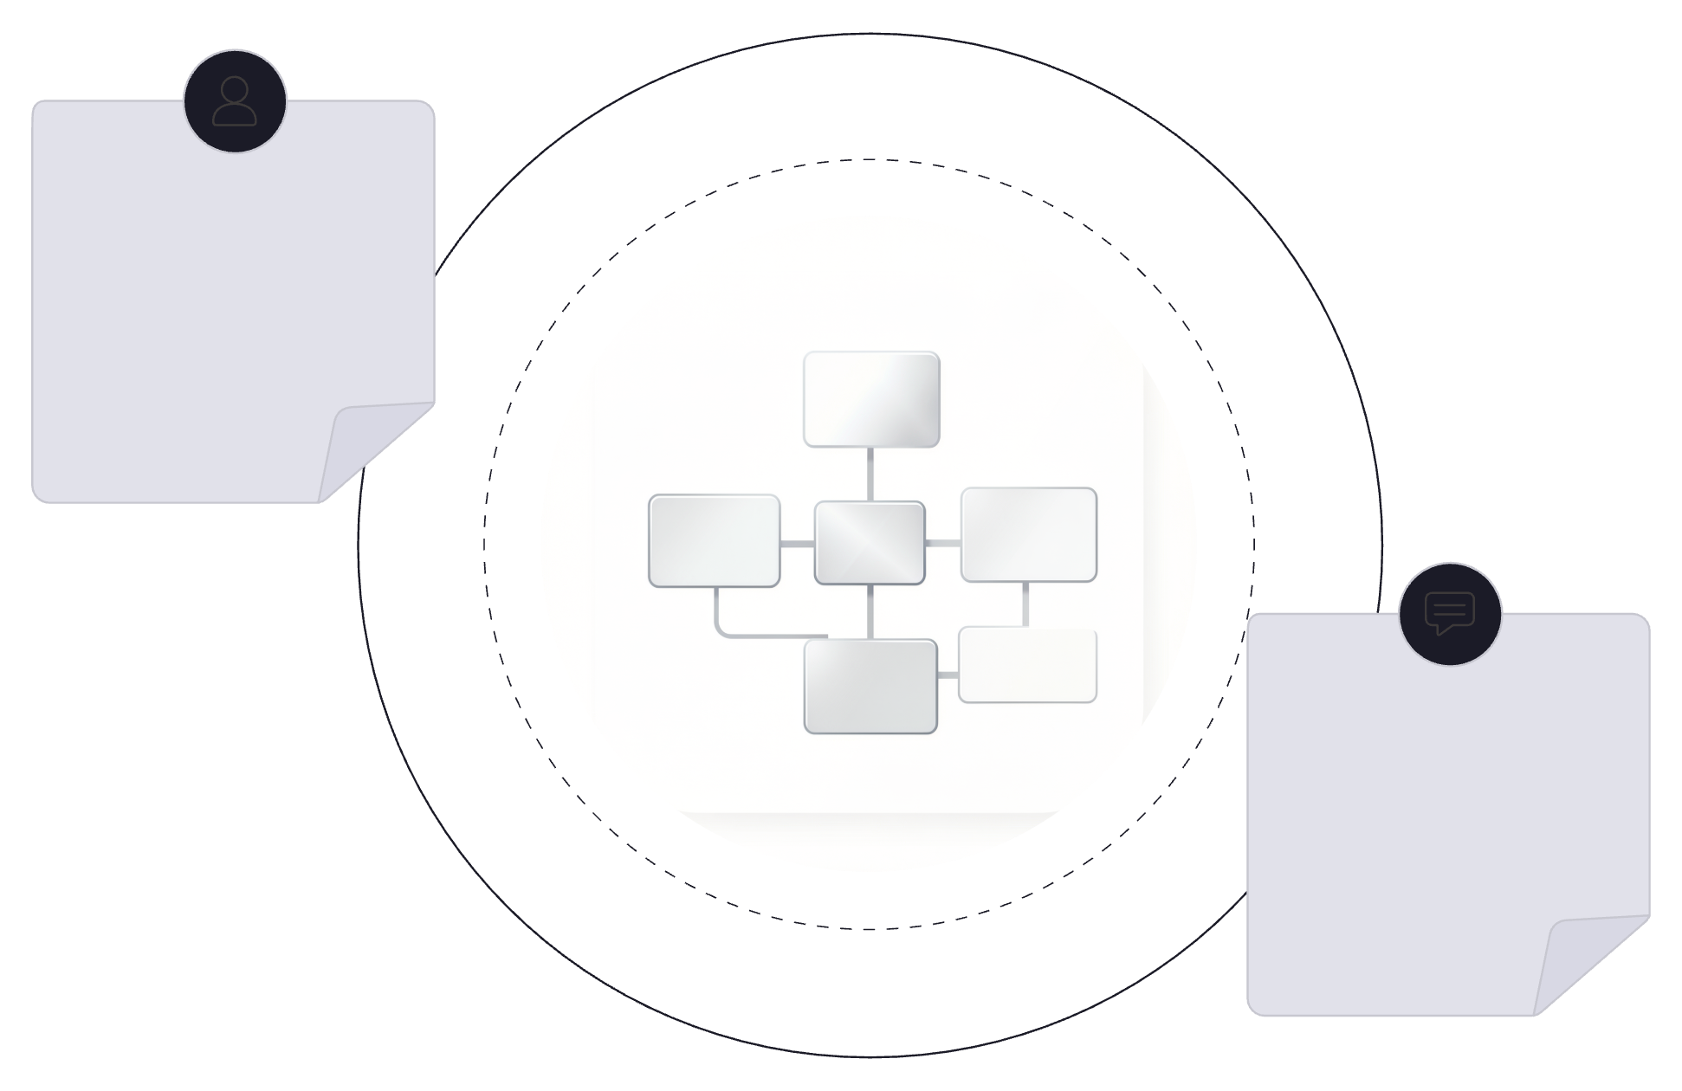
Data Model & Schema Design
Users → Posts
Users PK user_id → Posts FK author_id (1-to-many)
Posts → Comments → Likes
Post PK post_id → Comments FK post_id (1-to-many); Comments PK comment_id → Likes FK comment_id (1-to-many)
Our social media analytics solution is built upon a robust, normalized relational database schema. This structure, comprising seven interconnected tables, is optimized for data integrity and efficient querying. Each table is designed to hold specific types of information, preventing redundancy and ensuring accuracy across the dataset.
Normalized Structure: Data is organized to reduce redundancy and improve data integrity. Each table has a single responsibility.
Key Relationships: Primary Keys (PK) uniquely identify records, while Foreign Keys (FK) establish clear one-to-many relationships between entities, like users and their posts.
Efficient Querying: This design allows for complex JOIN operations without sacrificing performance, crucial for extracting deep insights from social media interactions.

Slide 11




Future Scope & Recommendations
Predictive Analytics
Real-Time Dashboards
Build ML models to forecast which content will go viral before it happens.
Implement Power BI / Tableau for live engagement tracking and monitoring.
Sentiment Analysis
Recommendation Engine
Analyze comment text for user sentiment and brand perception signals.
Suggest content to users based on individual engagement patterns and history.

Slide 12
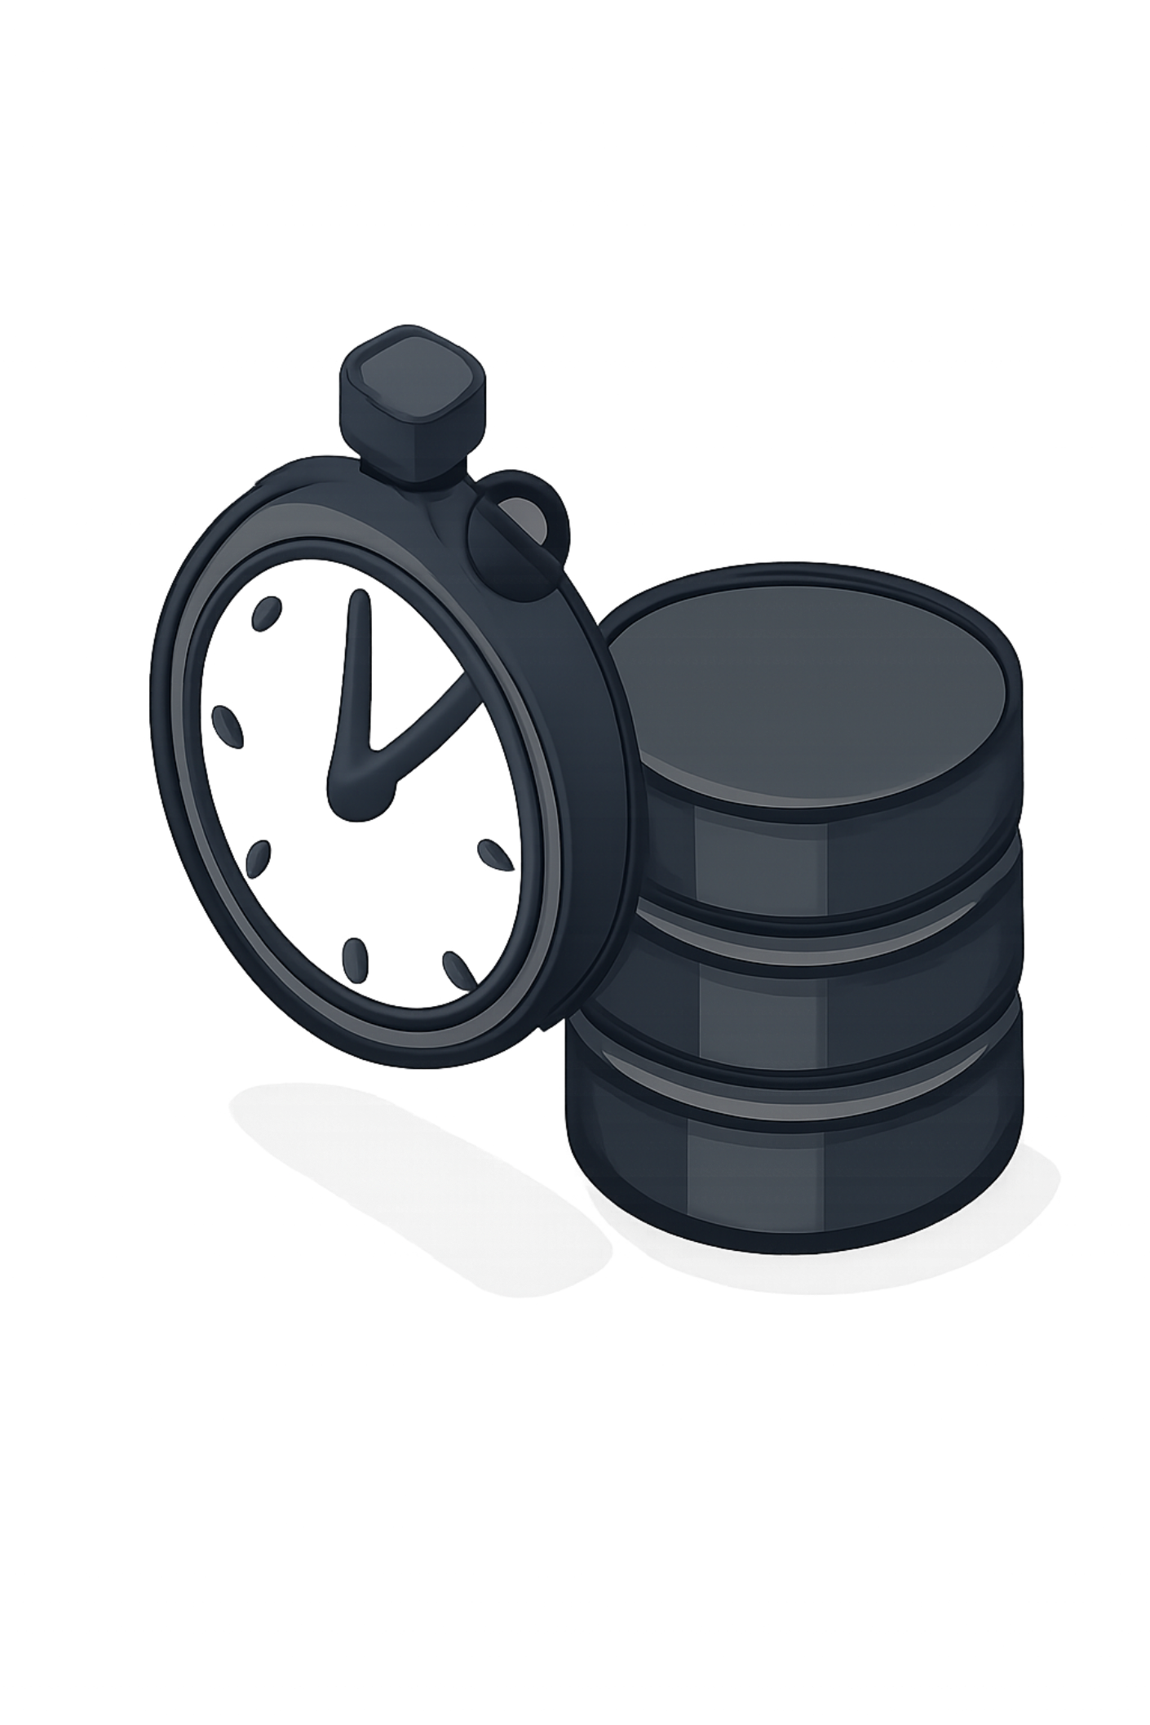

Query Performance & Optimization
1
2
Indexing Strategies
Advanced SQL Techniques
Applied B-tree and hash indexes to frequently queried columns, drastically reducing lookup times on large tables.
Leveraged CTEs for modularity and window functions for complex aggregations, improving both readability and execution speed.
3
Execution Plan Analysis
Systematically reviewed query plans to pinpoint and eliminate bottlenecks, ensuring optimal resource utilization.
GenAI Impact: Our GenAI assistant provided optimization suggestions and syntax validation, leading to a 30-50% reduction in average query execution time during development.

Slide 13

Conclusion & Outcome
Project Success
Delivered 10 core queries + 4 bonus analyses — fully on schedule.
Business Value
Actionable insights ready to drive platform growth and user engagement strategy.
Technical Growth
Mastered advanced SQL, query optimization, and data storytelling end-to-end.
Interview Ready
Confident in articulating both the technical depth and business impact of this project.

